Slide 1
Tree Traversal
Ryan Coon

Slide 2
Three of most common ways to traverse a tree are known as in-order, pre-order, and post-order.
An in-order traversal visits each of the nodes in order
In a preorder traversal, we first print ourself, then we print all the nodes to the left of us, and then we print all the nodes to the right of ourself.
In a post-order traversal, we visit everything to the left of us, then everything to the right of us, and then finally ourself.

Slide 3
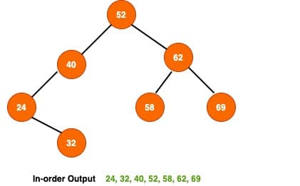
In the in-order binary tree traversal, we visit the left sub tree than current node and finally the right sub tree. Here is the high-level algorithm for BST in-order traversal.

Slide 4
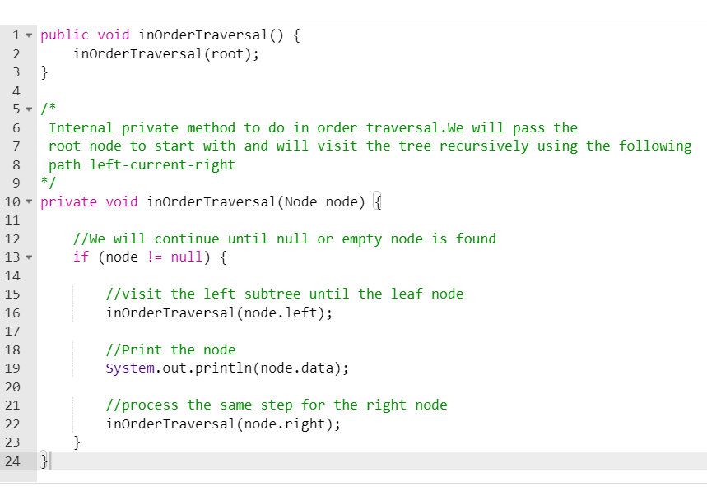

Slide 5
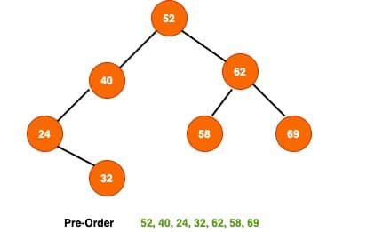
The pre-order binary tree traversal involve visit the current node followed by left sub-tree and finally the right sub-tree. Here is a high-level algorithm for preorder BST traversal.

Slide 6
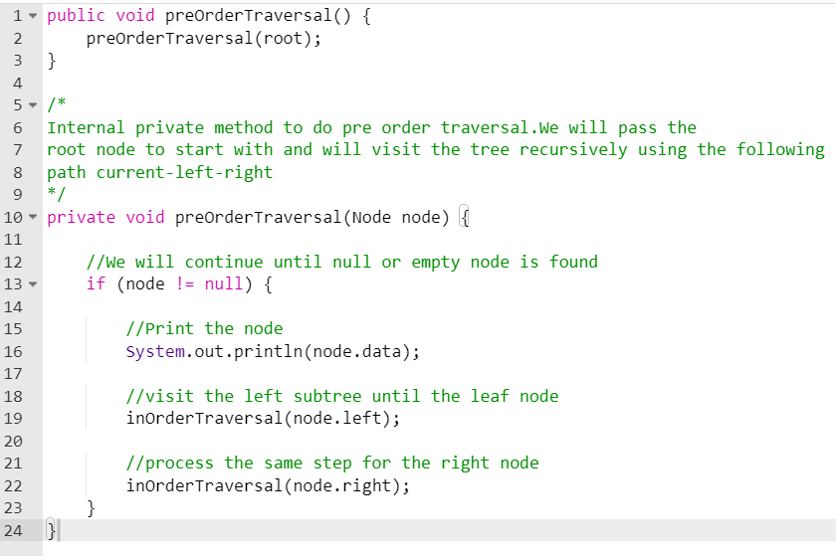

Slide 7
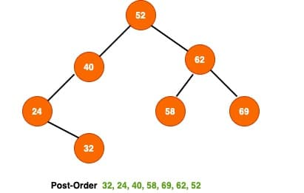
The post-order binary tree traversal, we traverse the left sub tree, the right sub-tree and finally visit the root node.Here is the algorithm for the post-order BST traversal.

Slide 8
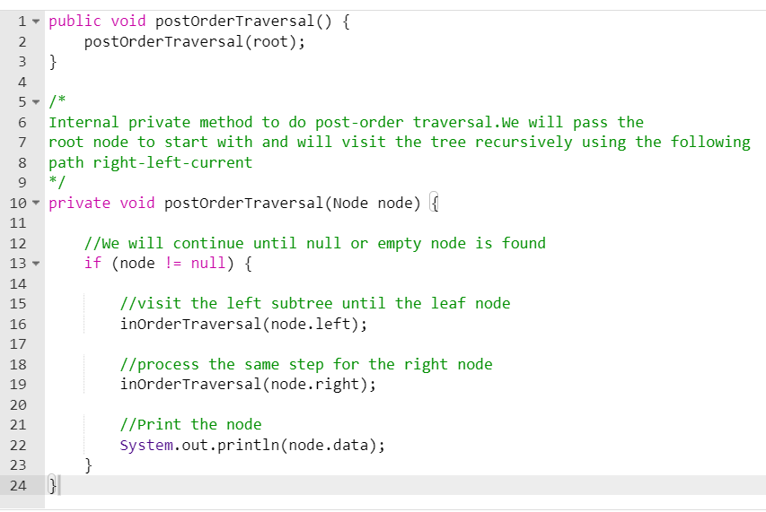

Slide 9
In the general case, all the traversal algorithms visit each node in a tree exactly once. Therefore, the time complexity of all the traversal algorithms would be O(N) when a tree contains N nodes.
In order to verify the overall time complexity, we’re taking a corner case, and we’re going to find the time complexity to visit all the nodes. If a tree has N nodes, then the time complexity T(N) of the tree can be defined as: T(N) = T(L) + (N - L - 1) + C
L is the number of nodes on the left side of the tree, and C denotes a constant time. Now let’s assume that the given tree is a right-skewed tree. In the case of a right-skewed tree, the left of the tree will be empty. So, L = 0:
T(N) = T(0) + (N – 1) + C
T(N) + 2T(0) + T(N – 2) + 2C
T(N) = 3T(0) + T(N -3) + 3C
If we continue, we’ll get:
T(N) = (N - 1)T(0) + T(1) + (N – 1)C
T(N) = NT(0) + (N)C
T(0) denotes traversing an empty tree which takes constant time:
T(N) = NT(0) + (N)C = NC + NC = 2NC = O(N)
Therefore, we verified that all the tree traversal algorithms take O(N) time.

